Slide 1

A Presentation
by
Kashyap Uppuluri
Shruti Vangari
Mukesh Kumar Chippa
Team 2

Slide 2
Aim
To find out important features of interest for a particular product and year
To compare the results from WEKA (using J48) and ROSE2
Products
Nokia 6610 – Manufactured in 2004
Nokia 6600 – Manufactured in 2009

Slide 3
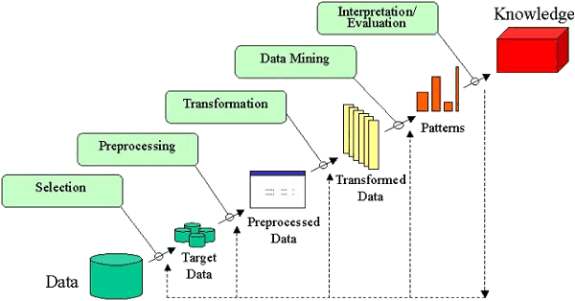


KDD Process
1. Accuracy
Using Approximations
2. Reducts
3. Decision Tree
Amazon Data Reviews
Nokia 6600 & 6610 reviews
Features & Attributes
Incomplete Information System Table

Slide 4
KDD Process
1. Accuracy
Using Approximations
2. Reducts
3. Decision Tree
Amazon Data Reviews
Nokia 6600 & 6610 reviews
Features & Attributes
Incomplete Information System Table

Slide 5
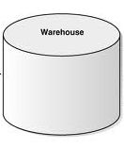

Define Data Source before KDD Process
Amazon Customer Review Data from Data Mob

Slide 6
KDD Process
1. Accuracy
Using Approximations
2. Reducts
3. Decision Tree
Amazon Data Reviews
Nokia 6600 & 6610 reviews
Features & Attributes
Incomplete Information System Table

Slide 7
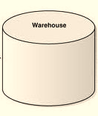
Process – Step1(Data Selection)
Nokia 6600 Reviews
Number of reviews collected = 100
Amazon Reviews
Nokia 6610 Reviews
Number of reviews collected = 95

Slide 8
KDD Process
1. Accuracy
Using Approximations
2. Reducts
3. Decision Tree
Amazon Data Reviews
Nokia 6600 & 6610 reviews
Features & Attributes
Incomplete Information System Table

Slide 9
Process – Step2(Preprocessing)
The reviews collected have been cleaned by removing the following manually:
  Stop words
  Emoticons
  Unwanted words
  Unrelated reviews
  (list is in the next slide)
Number of reviews after removing stop words is
For 6610 = 65 For 6600 = 60

Slide 10
Process – Step2(Preprocessing)
List of stop words and emoticons
Prepositions – in, at, as, besides, before, between…….
Symbols - ( ) , : # ‘ - . $ + [ ] { } “ ? % @ / _
Articles – a, an, the
Other words – about, all, almost, none, now, rather……

Slide 11
Process – Step2(Preprocessing)
Reviews that were not relevant for e.g.
“[t]sound good but complicated . ##do too many stuffs to get to a free phone after rebate . ##also , if i want a family plan , which mean i need tw phones on a plan .. .
##so how can i do that ... are n't that free for two after the rebates . ##and how can i do that ... . ##print those coupons twice for two phones ?”
These reviews contained unwanted data and are not related to this project and were hence not considered.

Slide 12
KDD Process
1. Accuracy
Using Approximations
2. Reducts
3. Decision Tree
Amazon Data Reviews
Nokia 6600 & 6610 reviews
Features & Attributes
Incomplete Information System Table

Slide 13
Process – Step 3 (Transformation)
Collect the list of features
Define the domain of the attributes
Number of features collected excluding review number & Orientation for
Nokia 6610 = 47
Nokia 6600 = 52
Features and attribute value pairs
Feature 1 – Attribute Value 1, Attribute Value 2
Feature 2 - Attribute Value 1, Attribute Value 2, Attribute Value 3
Feature 3 – Attribute Value 1
Feature 4 – Attribute Value 1, Attribute Value 2
The specifications and corresponding attributes collected for Nokia 6610 are described in the next slide

Slide 14
Transformation of data
List of features and their domain values for Nokia 6610(1)
Feature Name Domain of Attributes
Phone {Excellent, Good, Bad}
Radio {Excellent, Good, Bad}
Sound_Quality {Excellent, Good, Bad}
Speaker_Phone {Excellent, Good, Bad}
Width {Small, Medium, Large}
Depth {Small, Medium, Large}
Height {Small, Medium, Large}
Weight {Light, Medium, Heavy}

Slide 15
List of features and their domain values for Nokia 6610(2)
Feature Name Domain of Attributes
Installed_games {Excellent, Good, Bad}
Platform_supported {Excellent, Good, Bad}
Screen {Excellent, Good, Bad}
GPRS_Indicator {Good, Bad}
Connection_type {GSM, CDMA}
Technology {Excellent, Good, Bad}
Antenna {Excellent, Good, Bad}
Signal_strength {Excellent, Good, Bad}
GPRS_Indicator {Good, Bad}

Slide 16
List of features and their domain values for Nokia 6610(3)
Feature Name Domain of Attributes
Infrared {Excellent, Good, Bad}
Bluetooth {Excellent, Good, Bad}
Memory {Excellent, Good, Bad}
SMS {Excellent, Good, Bad}
Keypad {Excellent, Good, Bad}
MMS {Excellent, Good, Bad}
GPRS {Excellent, Good, Bad}
Volume {Good, Bad, Average}
Battery_life {Excellent, Good, Bad}

Slide 17
List of features and their domain values for Nokia 6610(4)
Feature Name Domain
Feature Name Domain
Vibrating_alert {Yes, No}
Call_timer {Yes, No}
Conference_call_capability {Yes, No}
Count_down_timer {Yes, No}
Stopwatch {Yes, No}
Multimedia_features {Yes, No}
Divert_Indicator {Yes, No}
Silent_ring_indicator {Yes, No}
Voice_message_waiting {Yes, No}
Sim_card_lock {Yes, No}
PC_sync {Yes, No}
Alarm_clock {Yes, No}
Calendar {Yes, No}
Reminder {Yes, No}
Calculator {Yes, No}
Converter {Yes, No}
Caller_ID {Yes, No}
Voicemail_capability {Yes, No}
Voice_recognition {Yes, No}
Phone_lock {Yes, No}

Slide 18
Mapping from features (1)
The following list gives the mapping definitions that were used to map the words from reviews to the domain attribute values definitions described above
Feature name | Words from review | Mapped Domain Attribute Name
Sound Quality | Crystal Clear | Excellent
Width | Decent Size | Medium
SMS | Texting in pain | Bad
Battery Life | Long | Excellent
Phone | Highly Recommended | Excellent
Phone | Huge Disappointment | Bad

Slide 19
Mapping from features(2)
In general, summarizing the mapping
Words from review | Mapped Domain Attribute Name
Great, best, nicest, cool, perfect, Excels , Amazing, Awesome, superb, very pleased, overwhelmed, ultimate, incredible, love, beautiful | Excellent
Fair, better | Good
Tiny | Small
Not very clear, horrible, worst, disappointed, dissatisfied, fed up, very unpleasant, thumbs down, disturbing | Bad
Decent | Medium

Slide 20
Process – Step 3(Transformation)
From the collection of reviews, extract the review and corresponding attribute value
Collection of Reviews
Review 1: ____ feature 1____
Review 2: ___Feature1,2,3__
Review 3: __Feature1,2,55,7___
Review 4: ____Feature 10,11___
..
.
.
.
.
.
.
Extract the following:
Review Number
Feature Name
Attribute Value for feature

Slide 21
KDD Process
1. Accuracy
Using Approximations
2. Reducts
3. Decision Tree
Amazon Data Reviews
Nokia 6600 & 6610 reviews
Features & Attributes
Incomplete Information System Table

Slide 22
Transformed Data
Map all the values in the format as shown
Review# | Phone | Camera | Speed_of_ Operation | Video_ Recording
1 | Excellent | * | * | *
2 | Excellent | Excellent | * | *
3 | Excellent | Excellent | * | Bad
4 | Bad | * | * | *
5 | Bad | * | * | *
6 | Bad | Bad | Slow | Bad
7 | * | Excellent | * | Excellent
* = Missing value

Slide 23
KDD Process
1. Accuracy
Using Approximations
2. Reducts
3. Decision Tree
Amazon Data Reviews
Nokia 6600 & 6610 reviews
Features & Attributes
Incomplete Information System Table

Slide 24






Process – Step 4 (Data Mining)
Using the following tools:
Transformed Data
(Table in previous slide)
Results

Slide 25
Experiment – Using WEKA

Slide 26

Experiment – Using WEKA (1)
The data needs to be written in a .arff format shown below:
@relation ‘FileName’
@attribute reviewnumber real
@attribute feature1 {Value1, Value2, Value3}
@attribute feature2 {Value1, Value2}
.
.
@attribute Orientation {P, N, Neutral}
@data
Value1, Value2,……………..Valuen
Value1, Value2,……………..Valuen
Value1, Value2,……………..Valuen

Slide 27
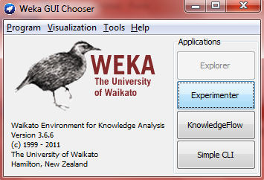
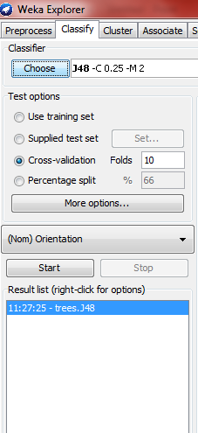
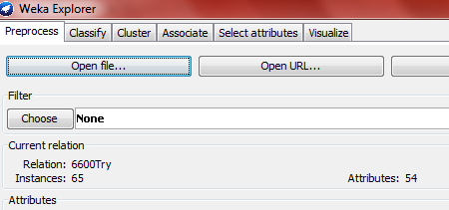
Experiment - Using WEKA (2)
Step 1
Step 3
Step 2
Step 4
Output = Decision Tree

Slide 28
Experiment – Using ROSE2

Slide 29

Experiment – Using ROSE2 (1)
The data needs to be written in a .isf format shown below:
**ATTRIBUTES
Decision : Orientation
Reviewnumber (numbercoded)
Feature1: [Value1, Value2, Value3]
Feature2: [Value1, Value2]
.
.
Orientation: [P, N, Neutral]
**EXAMPLES
Value1 Value2 ……………..Valuen
Value1, Value2,……………..Valuen

Slide 30
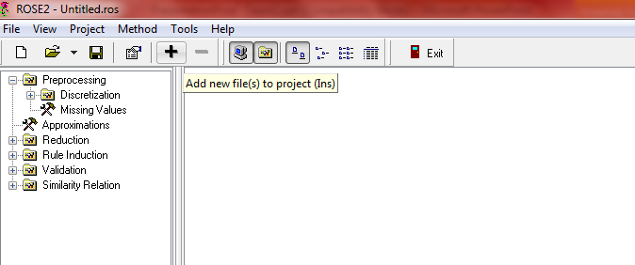
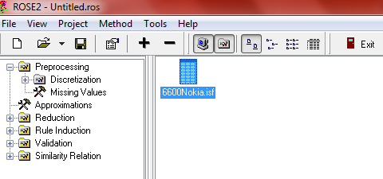
Experiment – Using ROSE2 (2)
Step 1
Step 2

Slide 31
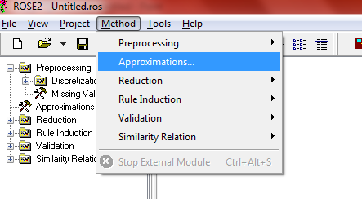
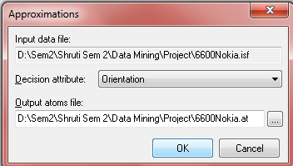
Experiment – Using ROSE2 (3)
To generate approximations
Step 1
Step 2
Output = Lower Approximation, Higher Approximation, Accuracy

Slide 32
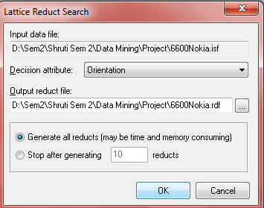
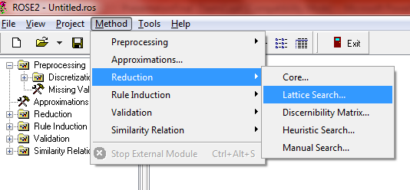
Experiment – Using ROSE2 (4)
To generate the reducts
Step 1
Step 2
Output = Reducts Log

Slide 33



Processing Reducts Log
Reducts Log
Count feature frequency list (Java Code)
Sort list in descending order
Reduct #1=
{F1, F2, F11)
Reduct #2=
{F3,F5,F20}
Feature Count
Voice Recognition 238
GPRS Indicator 226
Antenna 230
Feature Count
Voice Recognition 238
Antenna 230
GPRS Indicator 226

Slide 34
Results
Process – Step 5 (Interpretation)

Slide 35
KDD Process
1. Accuracy
Using Approximations
2. Reducts
3. Decision Tree
Amazon Data Reviews
Nokia 6600 & 6610 reviews
Features & Attributes
Incomplete Information System Table

Slide 36
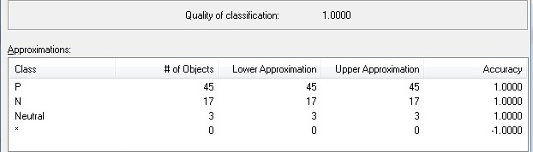
Approximations using ROSE2
2004 Data – Nokia 6610

Slide 37
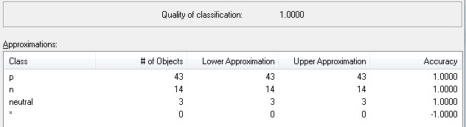
Approximation using ROSE2
2009 Data – Nokia 6600

Slide 38
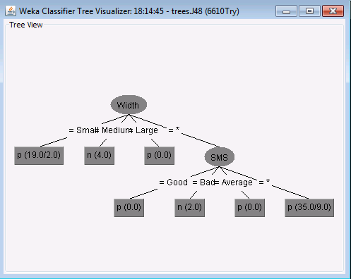
Decision tree using J48 filter- WEKA
2004 Data – Nokia 6610

Slide 39
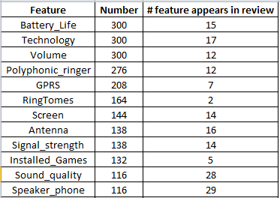
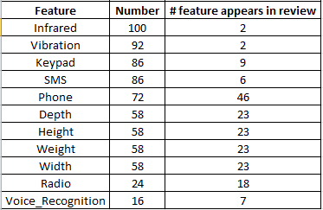
Feature frequency in Reducts – ROSE2
2004 Data - Nokia 6610
Total Number of Reducts generated = 301
Notes:
# feature mentioned in the review

Slide 40
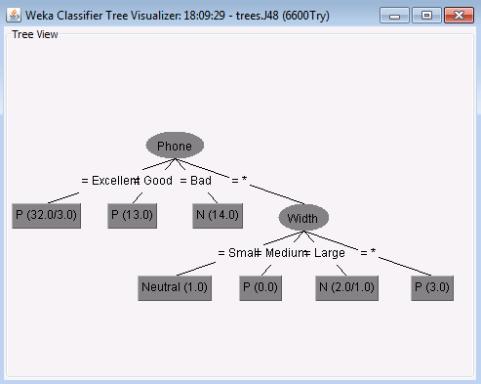
Decision tree using J48 filter- WEKA
2009 Data – Nokia 6600

Slide 41
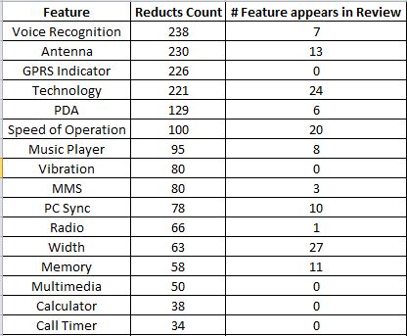
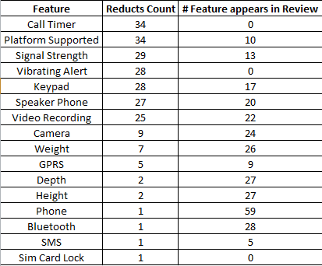
Feature frequency in Reducts – ROSE2
2009 Data - Nokia 6600
Total Number of Reducts generated = 239

Slide 42
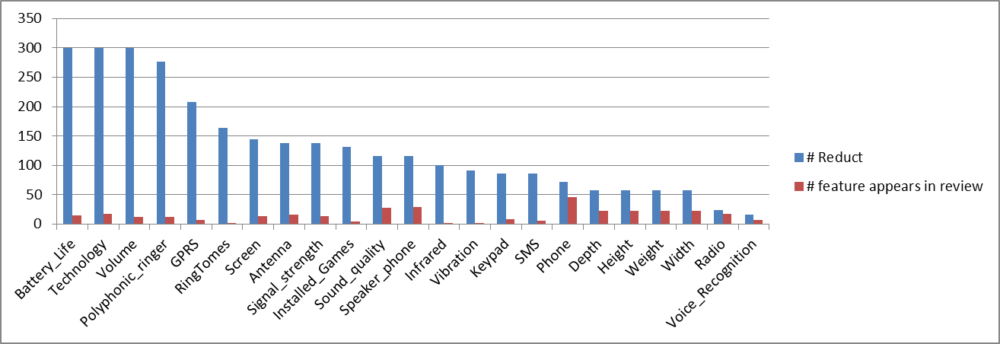
Conclusions
Nokia 6610 – 2004 data

Slide 43
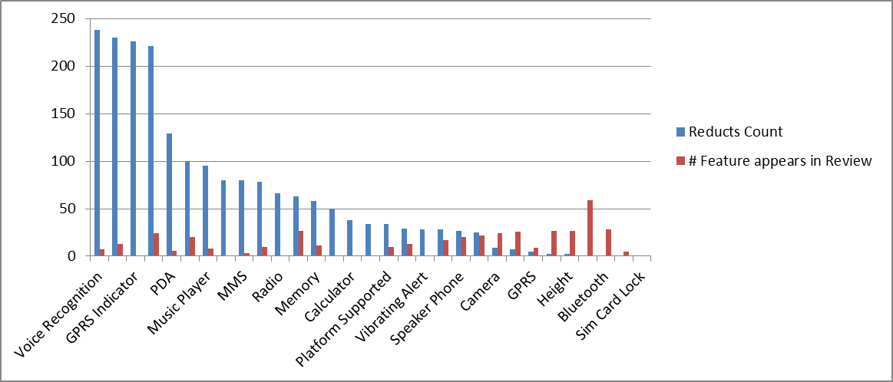
Conclusions(2)
Nokia 6600 – 2009 data

Slide 44
Conclusions(3)
WEKA had identified the following features:
2004 Data – NOKIA 6610 – Width, SMS
2009 Data – NOKIA 6600 – Phone, Width
The top few features that ROSE2 identified were:
2004 Data – NOKIA 6610 – Battery Life, Technology
2009 Data – NOKIA 6600 – Voice Recognition, Antenna

Slide 45
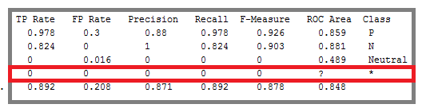
Conclusions(4)
WEKA produced the Detailed accuracy by class for Nokia 6600 as:
Hence, we can conclude that WEKA cannot handle missing values for discrete inputs[7]

Slide 46
Conclusions(5)
For discrete values, the missing value becomes a new value. Hence, this operation is not reported to WEKA and the no. of values of the variable is incremented[7]
For continuous values, missing values are replaced with computed average on the data. [7]
Since this project had discrete data, the missing values could not be accounted for.

Slide 47
Future Work
2004 Data
Camera
Cannon G3
MP3 Player
Creative Labs
Other products
2009 Data
Camera
Cannon power shot
MP3 Player
Micromp3/Ipod
Other products
Compare

Slide 48
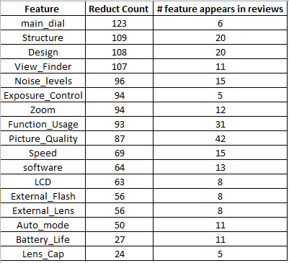
Cannon G3 using ROSE 2
# Reviews collected = 70
# Features considered = 18
# Reviews after preprocessing = 45

Slide 49
References
[1] Amazon database www.amazon.com, www.datamob.org
[2] ROSE2 tutorial http://idss.cs.put.poznan.pl/site/rose.html
[3] WEKA homepage http://www.cs.waikato.ac.nz/ml/weka/
[4] KDD process http://www2.cs.uregina.ca/~dbd/cs831/notes/kdd/1_kdd.html
[5] Minqing Hu and Bing Liu. 2004. Mining opinion features in customer reviews. In Proceedings of the 19th national conference on Artifical intelligence (AAAI'04), Anthony G. Cohn (Ed.). AAAI Press 755-760.

Slide 50
References(2)
[6] Minqing Hu and Bing Liu. 2004. Mining and summarizing customer reviews. In Proceedings of the tenth ACM SIGKDD international conference on Knowledge discovery and data mining (KDD '04). ACM, New York, NY, USA, 168-177. DOI=10.1145/1014052.1014073 http://doi.acm.org/10.1145/1014052.1014073
[7] http://eric.univ-lyon2.fr/~ricco/tanagra/fichiers/en_Tanagra_Handle_WEKA_File.pdf

Slide 51
Questions?

Slide 52
Thank You ☺

